Slide 1
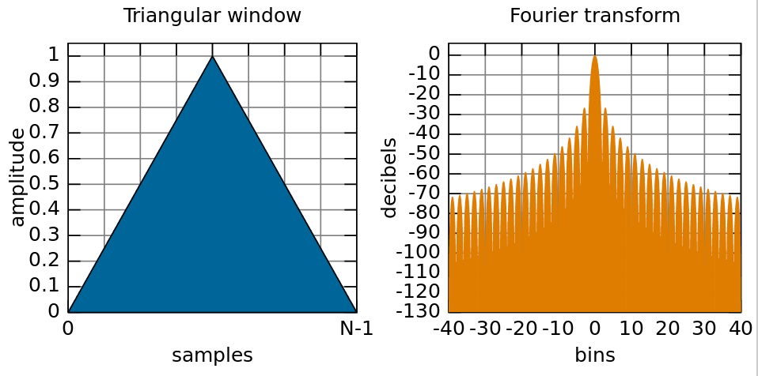
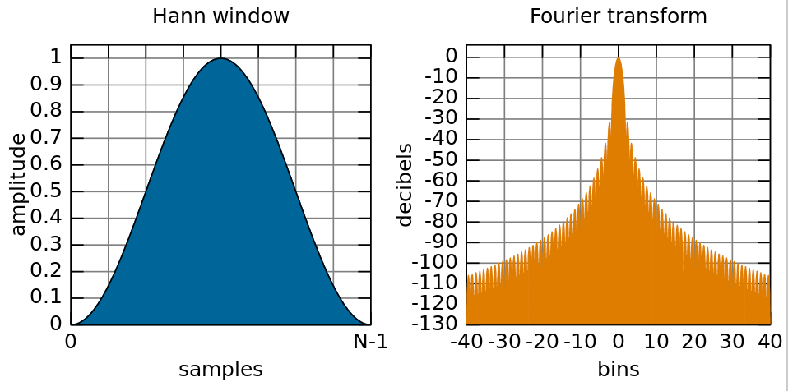
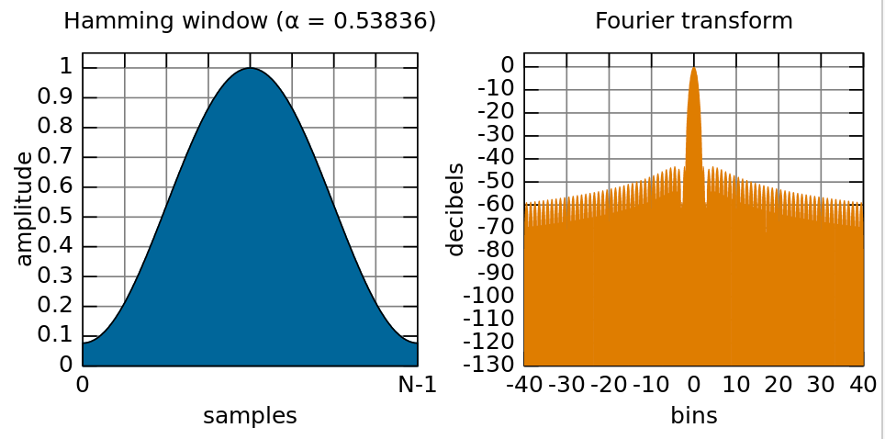
Phase vocoder, part 2
Look more at working in frequency domain
Window functions: why and how
Constant Overlap-Add (COLA) criterion
Analysis and synthesis windows
Reconstructing exact frequency from FFT bin phase
FFT-based frequency detector

Slide 2
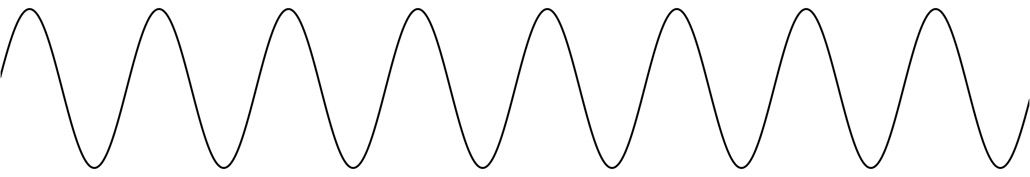
Sine wave in the frequency domain
What does the FFT of a single sine wave look like?
Let’s suppose its frequency exactly matches a bin: 2πk/N for some k
This means that an integer number of oscillations fit in the window
...
x[n]
All energy is in one frequency bin
All other bins 0 (except mirror image above Nyquist)
Magnitude is constant no matter where the window starts
Phase may change depending on window location
Xk
(lower half)

Slide 3
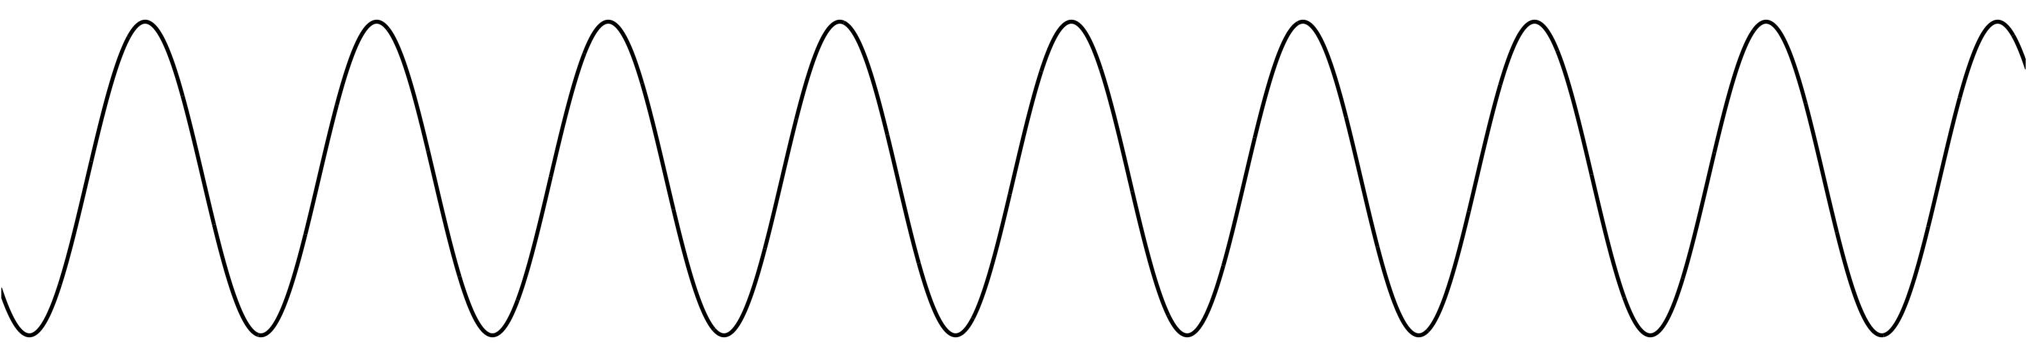
Sine wave in the frequency domain
What if frequency doesn’t exactly match any bin?
Energy smears out across all the other frequency bins (we’ll see why shortly)
Phase is likely to be different on each successive hop
If we’re clever, we can reconstruct the exact frequency based on the phase changes!
x[n]
Non-integer number
of periods
Xk
Energy spills over into
other bins, especially close neighbours
(lower half)

Slide 4
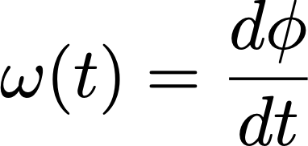

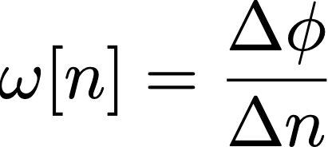
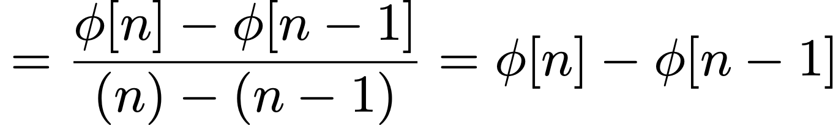
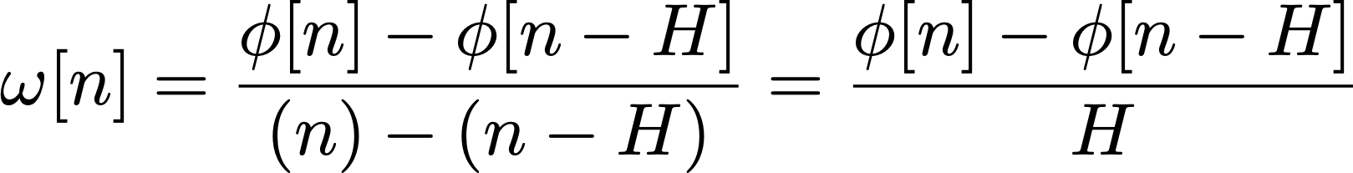
Reconstructing exact frequency
Can estimate exact frequency of sine wave from FFT
Even though FFT only has bins at fixed, regularly spaced frequencies!
Need two hops
Two snapshots of signal taken known length of time apart
Frequency is derivative of phase
In discrete time:
Generalising over hop of H samples:
y

Slide 5
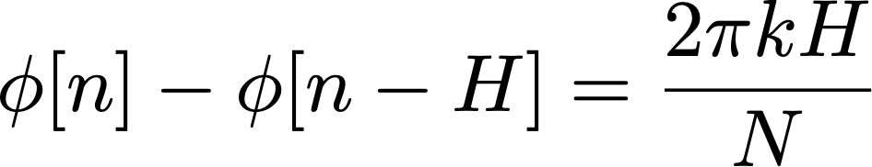
Reconstructing exact frequency
Calculating frequency from phase in discrete time:
In discrete time, frequency 𝜔 normalised between 0 and 2π;
Assumes unwrapped phase (i.e. always increasing, not constrained 0-2π)
Invert this formula to calculate phase shift based on frequency:
For DFT of size N, we know bin k has frequency of 2πk/N
For a sine wave of exactly the bin frequency, this is the expected phase shift over 1 hop:
By subtracting off this expected phase shift, remainder will tell us whether actual frequency is higher or lower than bin frequency

Slide 6
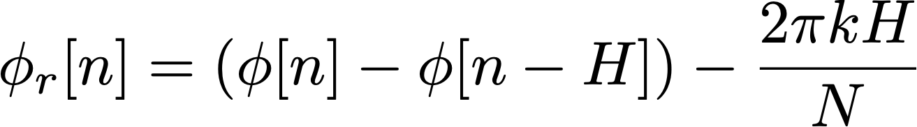
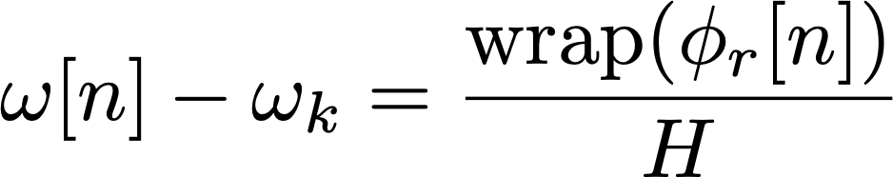
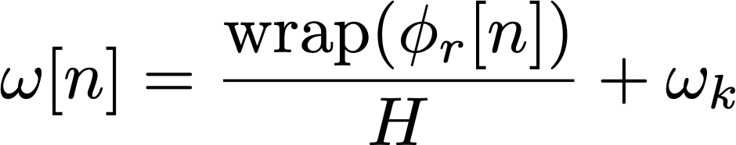
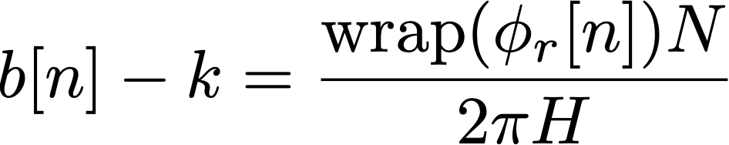
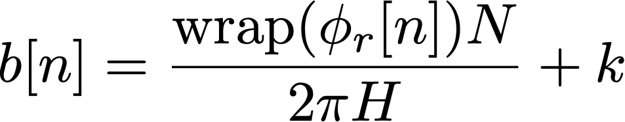
Reconstructing exact frequency
First calculate phase remainder:
Then use remainder to calculate deviation from bin centre frequency:
Should wrap phase to be between -π and π (i.e. principal argument)
Finally, rearrange to get exact frequency of our sine wave:
We could also calculate in terms of (fractional) FFT bins
Use the fact that bins are spaced 2π/N apart in frequency
measured phase values from bin k on two successive hops
centre frequency of bin k
multiplied by the hop size
centre frequency of bin k (= 2πk/N)
fractional bin number
of the sine wave

Slide 7
Reconstructing exact frequency: code
Effectively, we predict how far phase ought to advance from one hop to next, then compare actual measured values
Phase advancing farther means higher frequency (compared to bin frequency)
Phase advancing less far means a lower frequency
What do we need to implement this in code?
A global (or static) variable to hold phase of each bin
Saving each bin implies an array
Similar to saving previous values of x[n] or y[n] for a filter
A function to wrap phase to range -π to π
Implement calculations inside our process_fft() function
Write a for() loop iterating across each bin
y
prediction

Slide 8
Reconstructing exact frequency: task
Task: Write code to work out exact frequency of each bin
Implement these formulas:
Remember you will need a global or static array to hold previous phases
Same formula can apply to every bin regardless of magnitude
In practice, we only look at the first half of bins because the DFT is conjugate symmetric
hop size
bin phase this hop
bin phase last hop
FFT
size
bin
number
wrapPhase()
written for you
bin centre frequency
(2πk/N)

Slide 9
Choosing an FFT size
Previous formulas gave us one frequency component for each bin
FFT of size N has (N/2+1) unique bins after accounting for symmetry
Tells us maximum number of frequency components we can represent
N time-domain samples ↔︎ N frequency-domain bins
Larger FFT → greater frequency resolution
Bins spaced more closely together in frequency: 2πk/N
Easier to resolve two closely-spaced frequency components of signal
Trade off:
Fundamental mathematical limitations
Resolving short transient events within long time window is difficult
Poor time resolution, long latency

Slide 10
Choosing a hop size
How often should we take FFT?
Assuming we want to reconstruct signal, hop size H must be no more than FFT size N
Advantages of smaller hop sizes
More frequent time snapshots of signal
Phase of each bin advances less from one hop to next,
improving frequency estimation
Some types of window need a hop size of N/2, N/3 or even less to reconstruct the signal
Lower latency for phase vocoder effects
Disadvantages of smaller hop sizes
More computationally expensive
Hop sizes that aren’t integer division of FFT size can lead to artefacts on reconstruction
H = N
H = N/2
H = N/4

Slide 11
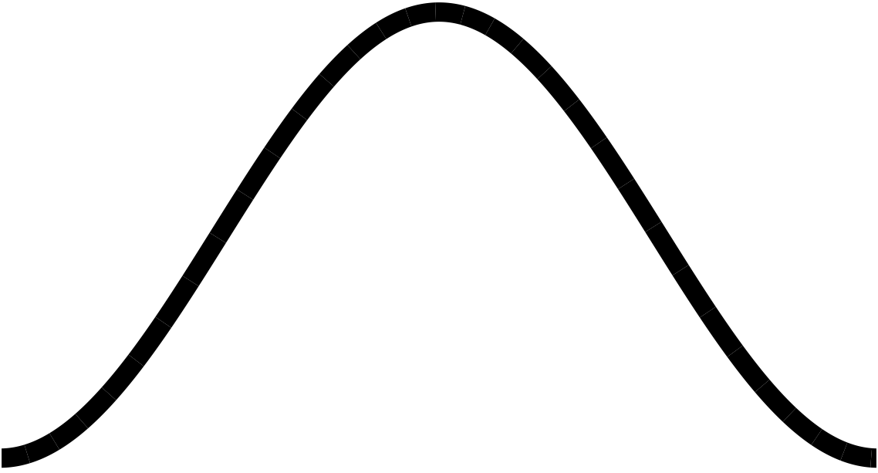
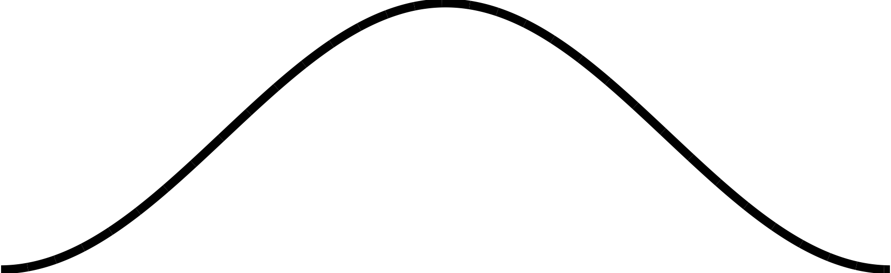
Windowing
Overlap-Add process segments signal into finite-length windows
These segments can have discontinuities at the edges (assuming 0 outside the window)
We might not notice this if we just reconstruct the signal with no frequency-domain processing
If we modify the signal, these sharp edges can lead to crackling or buzzing sounds
We can use a window function to taper the edges
Pre-calculated shape that we multiply the segment by before FFT
H = N/4
sharp edges
Hann window

Slide 12
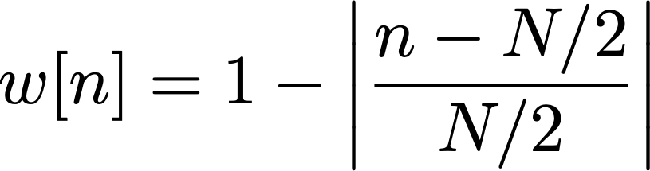


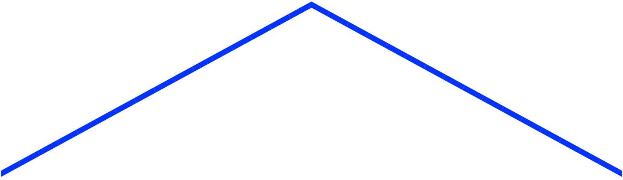
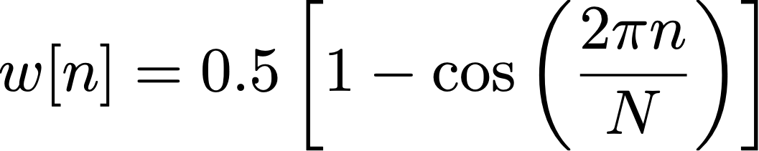
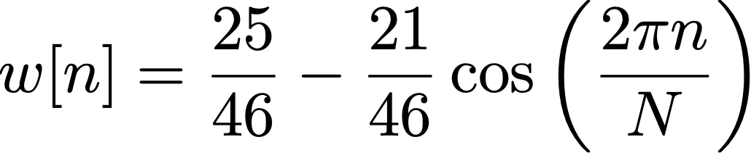
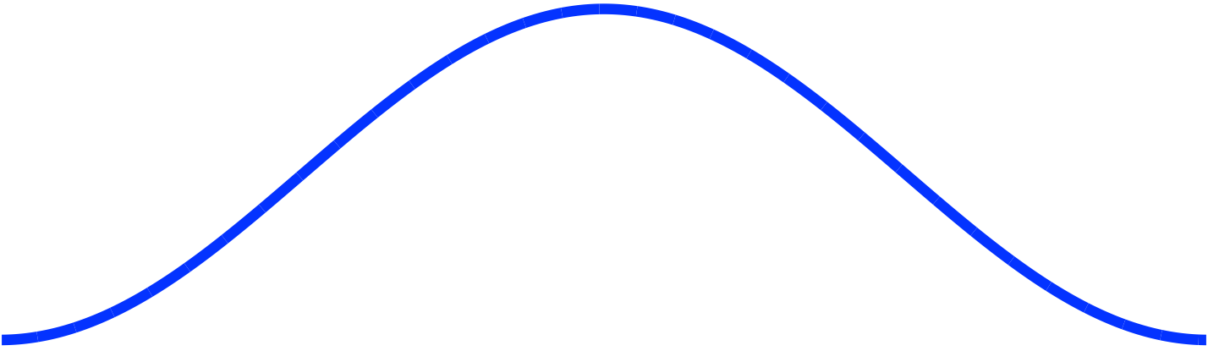
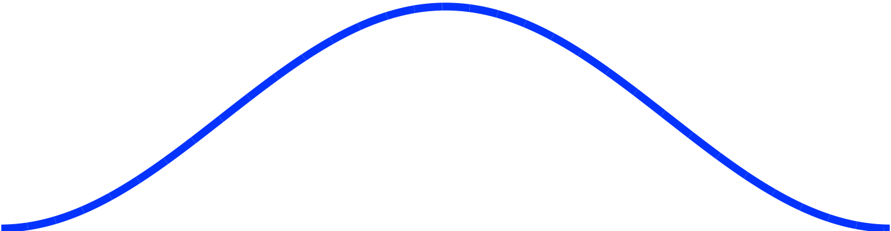
Types of window function
Rectangular
Triangular (Bartlett)
for
Hann
Hamming

Slide 13
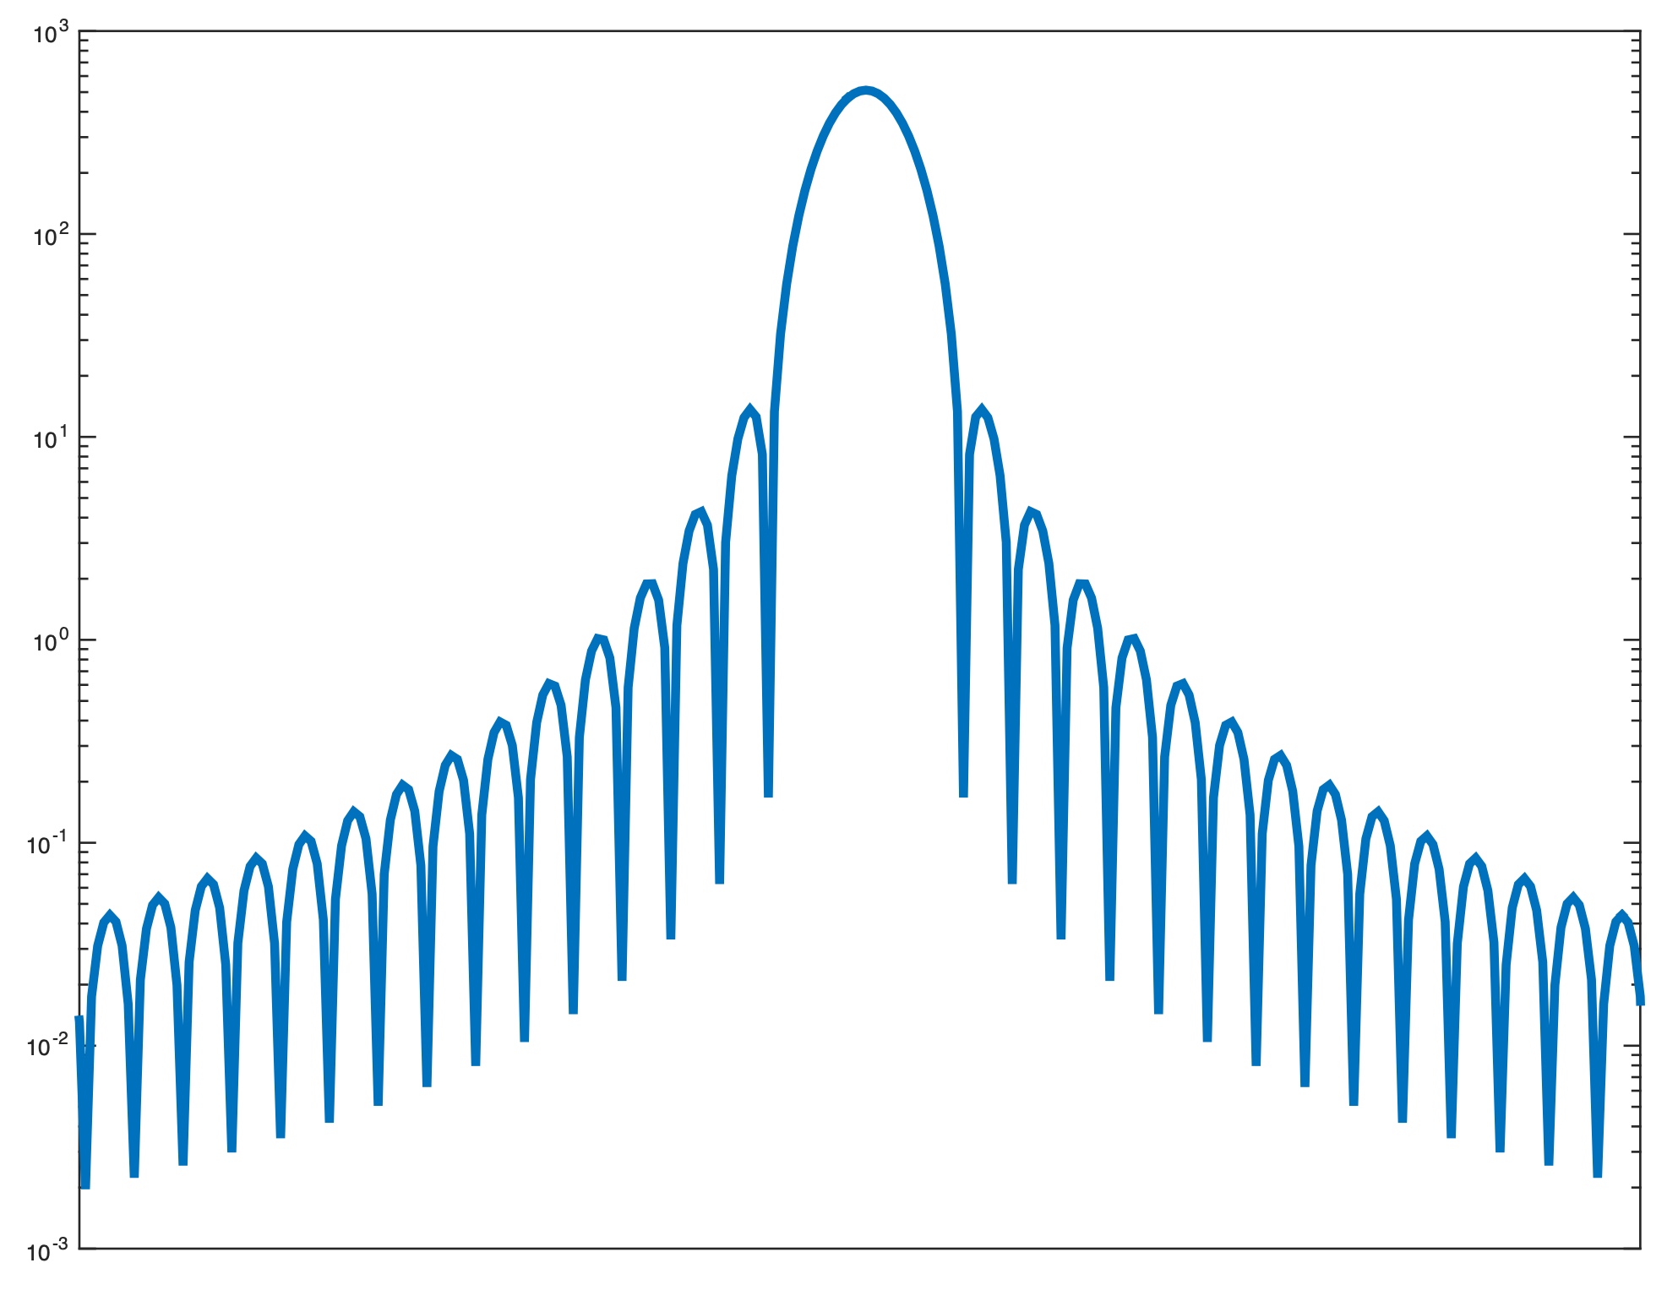
Effects of windowing
Windowing lets us isolate a particular time segment of our signal
The cost is smearing of energy in the frequency domain
Energy appears at frequencies where it doesn’t exist in the original signal
Each frequency component of the signal appears as a series of lobes
Main lobe: a broad peak centred around the actual frequency
Side lobes: secondary peaks at other frequencies
We typically want to minimise:
Main lobe width
Side lobe height
Side lobe height
(expressed in dB)
Main lobe width
(expressed in
frequency)
Hann-windowed
spectrum
(frequency smearing)
ideal signal
(all energy at one
frequency)

Slide 14
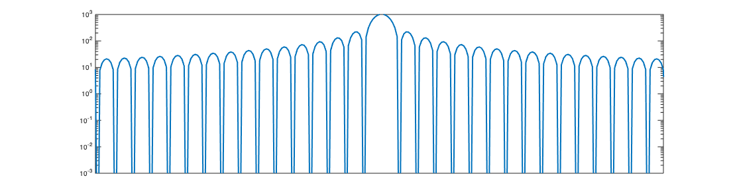
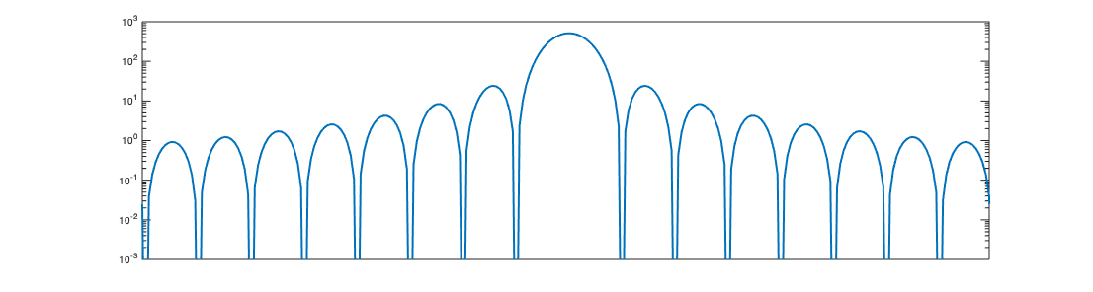
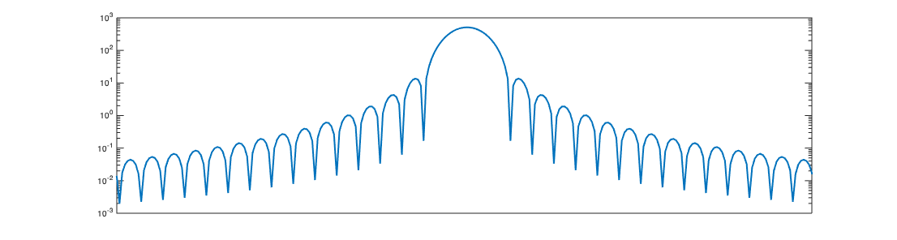
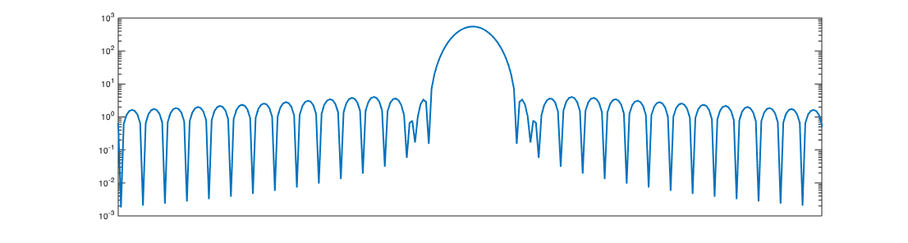
Window spectra
Rectangular
Triangular (Bartlett)
Main lobe width: 4π/N
Side lobe height: -13dB
Main lobe width: 8π/N
Side lobe height: -26.5dB
Hann
Hamming
Main lobe width: 8π/N
Side lobe height: -31.5dB
Main lobe width: 8π/N
Side lobe height: -42.8dB
→ When in doubt: use a Hann window

Slide 15
Coding a window
It is most efficient to pre-calculate the window when the program starts
Then recalculate when settings change: window size, window type etc.
Store the window in an array (typically a global variable)
Length of the array is equal to the window size
To calculate, use a for() loop to iterate over each sample of the window
To apply, multiply the signal by the window buffer frame-by-frame
Could do this while unwrapping a circular buffer (see Lecture 18)
const int windowSize = 1024;
float windowBuffer[gWindowSize];
for(unsigned int n = 0; n < windowSize; n++) {
windowBuffer[n] =
}
equation for window
for(unsigned int n = 0; n < windowSize; n++) {
windowedSignal[n] = originalSignal[n] * windowBuffer[n];
}

Slide 16
Visualising effects of windowing
Let’s go back to our fft-sine project and see the window in action
Task: in fft-sine, implement a Hann window
Change the frequency in the GUI so it doesn’t align with any bin
What happens to the width of the main lobe?
What happens to the side lobes?
As a bonus, Hann window should improve frequency estimation!
Why didn’t we see the classic comb filter pattern?
Because window size is the same as the FFT size
The FFT is effectively sampling the peaks of each lobe
Task 2: in setup(), change the window size to be a fraction of the FFT length
Say 1/4 or 1/8 of the FFT length
Now the lobes should be visible

